Slide 1
STUDY TRACKER APPLICATION
TEAM NUMBERS :
KUMARESH N M (E0320004)
ADHITHYAN B (E0320005)
DHRISH S KUMAR (E0320008)
ROHIT A CH (E0320022)

Slide 2
OBJECTIVES
To Help individuals and teams set goals and track their progress towards those goals.
They give you a structured way to track and visualize your goal progress through features like dashboards and progress bars.
It creates ownership of goal achievement.

Slide 3
Benefits of Study Tracker
Accelerate learning.
Make appropriate instructional adjustments.
Document every user's academic advancement.
Minimize special education referrals.
users are encouraged to take ownership of their learning, which helps them to develop the skills needed for learner agency—knowledge of oneself as a learner.
Review your progress regularly in a visual representation.
JUNE 2022
MOBILE APPLICATION
3

Slide 4
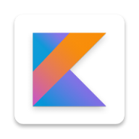




Tools and technologies used
ANDROID STUDIOS
KOTLIN
JAVA
FIREBASE
JETPACK

Slide 5
Modules used
Module 1 : Fundamentals of Mobile Programming
Android Studio
Emulators
Gradle Build System
Manifest File
Module 2 : Android Components
Text views
Buttons
Edit texts
Image View
Spinner
Module 3 : Android Components
Toast Messages
Snack bar Messages
Constraint Layout
List View
Module 4 : Lifecycles and Shared Preferences
Activity
Fragments
Intents
Shared Preference Class

Slide 6

WORKFLOW
Start
Splash Screen
Login/Register
Main Screen
Home Page
Subject Page
Analytics Page
Profile Page

Slide 7
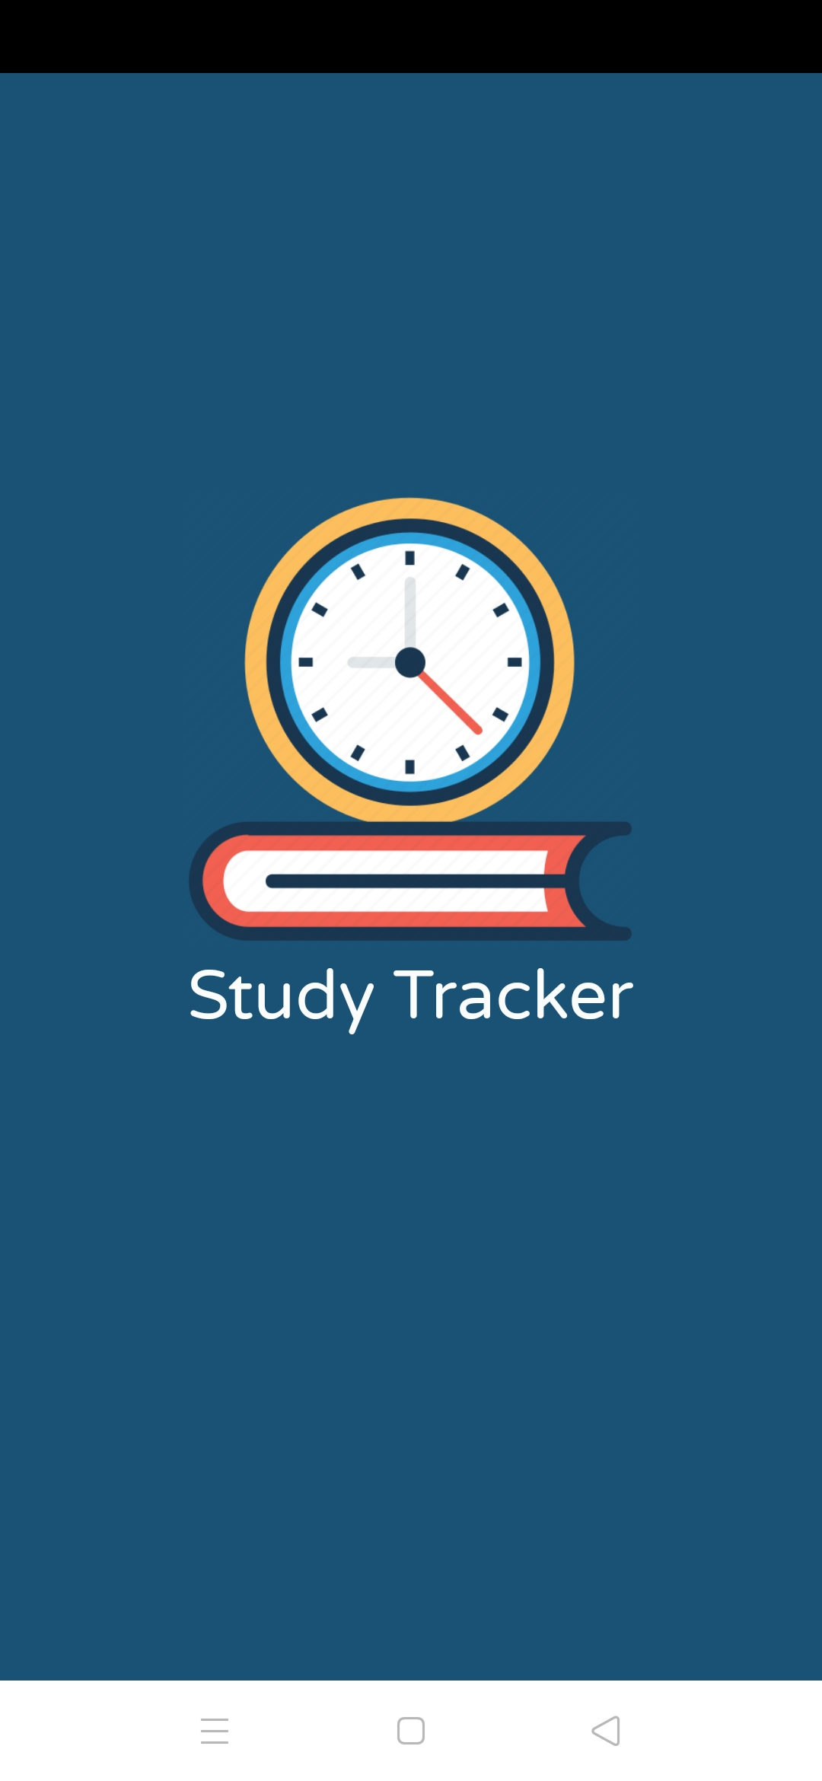
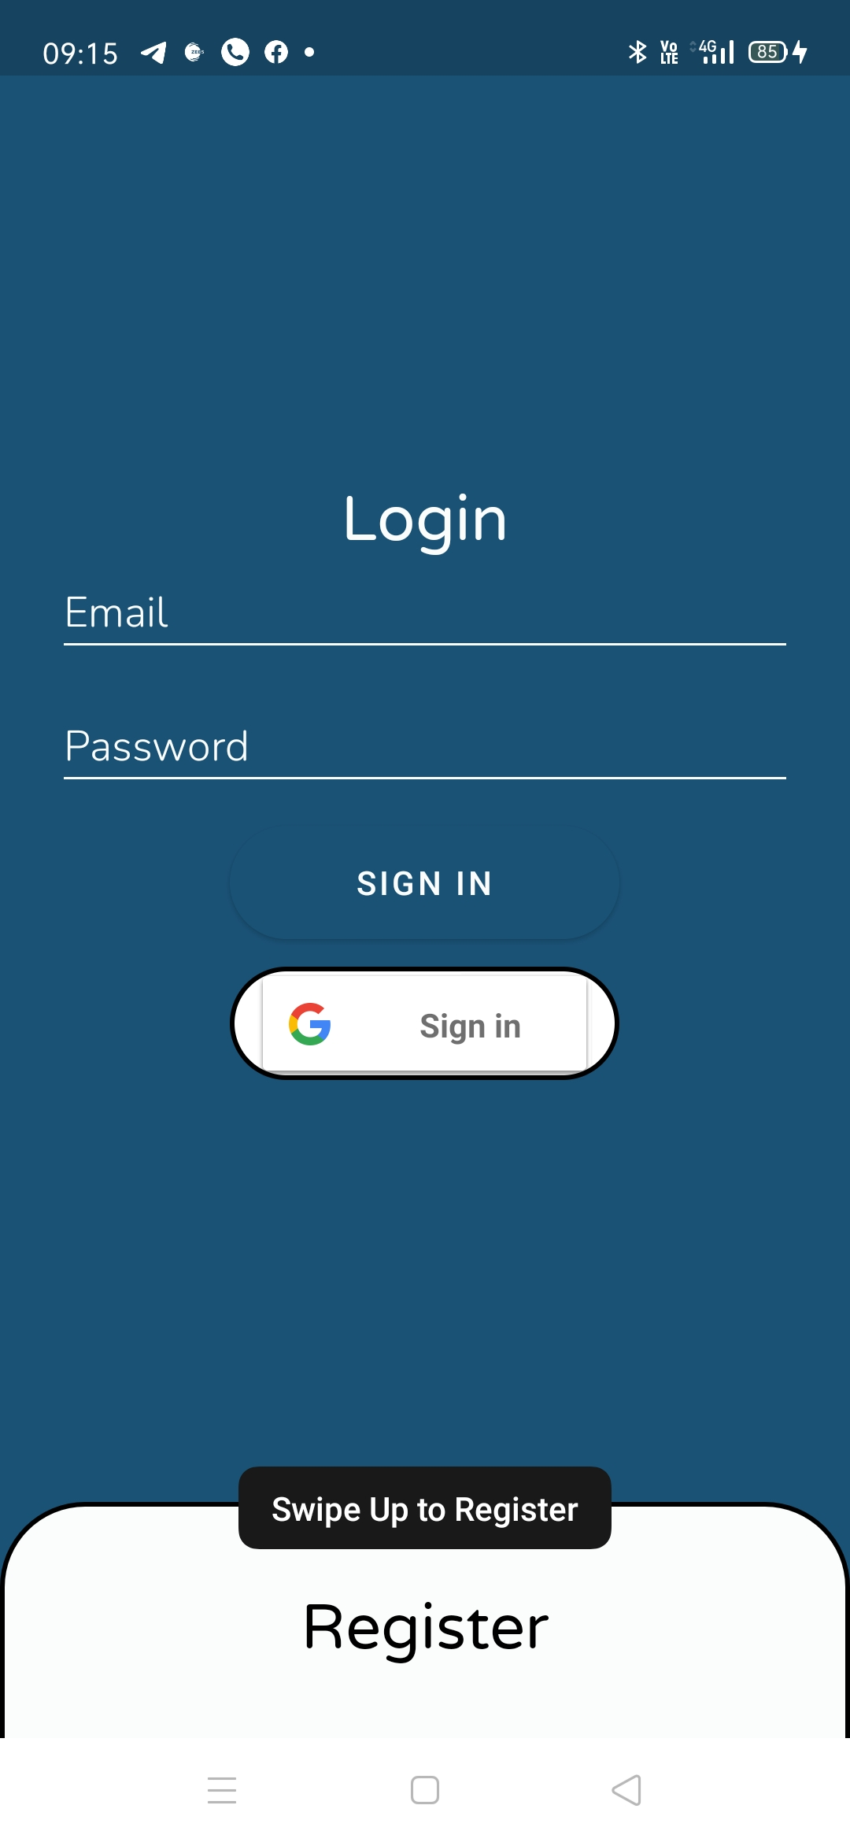
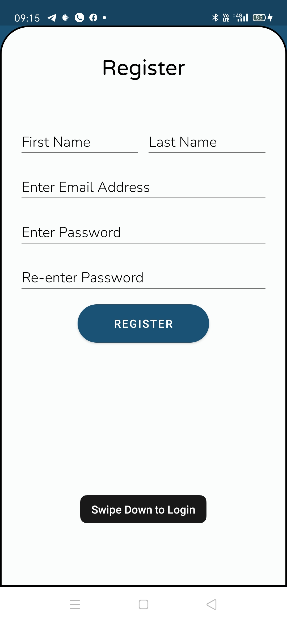
SCREENSHOTS

Slide 8
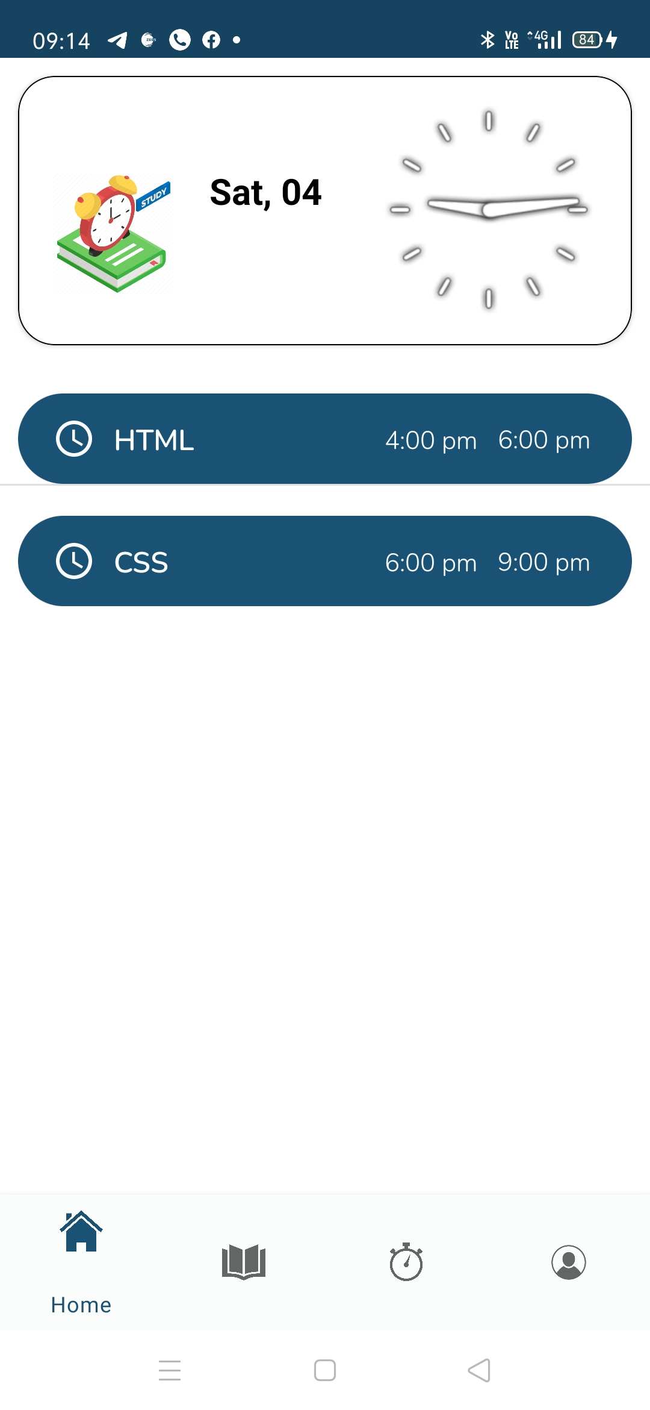
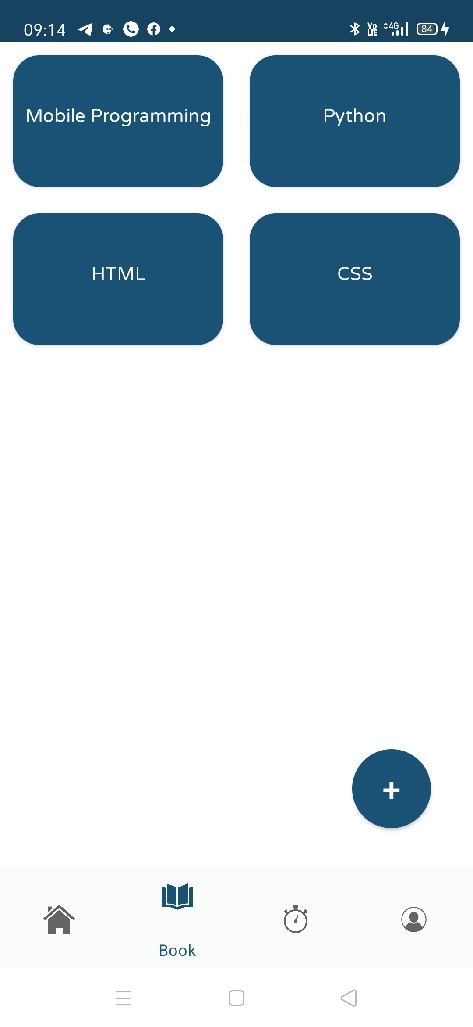
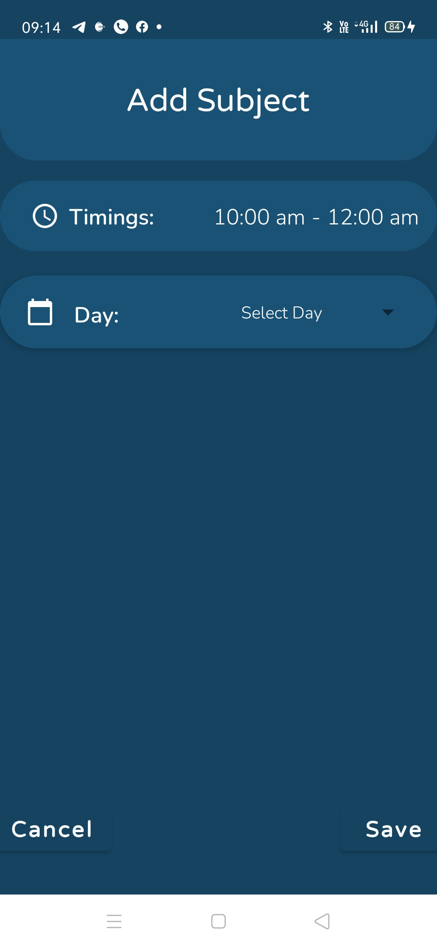
SCREENSHOTS

Slide 9
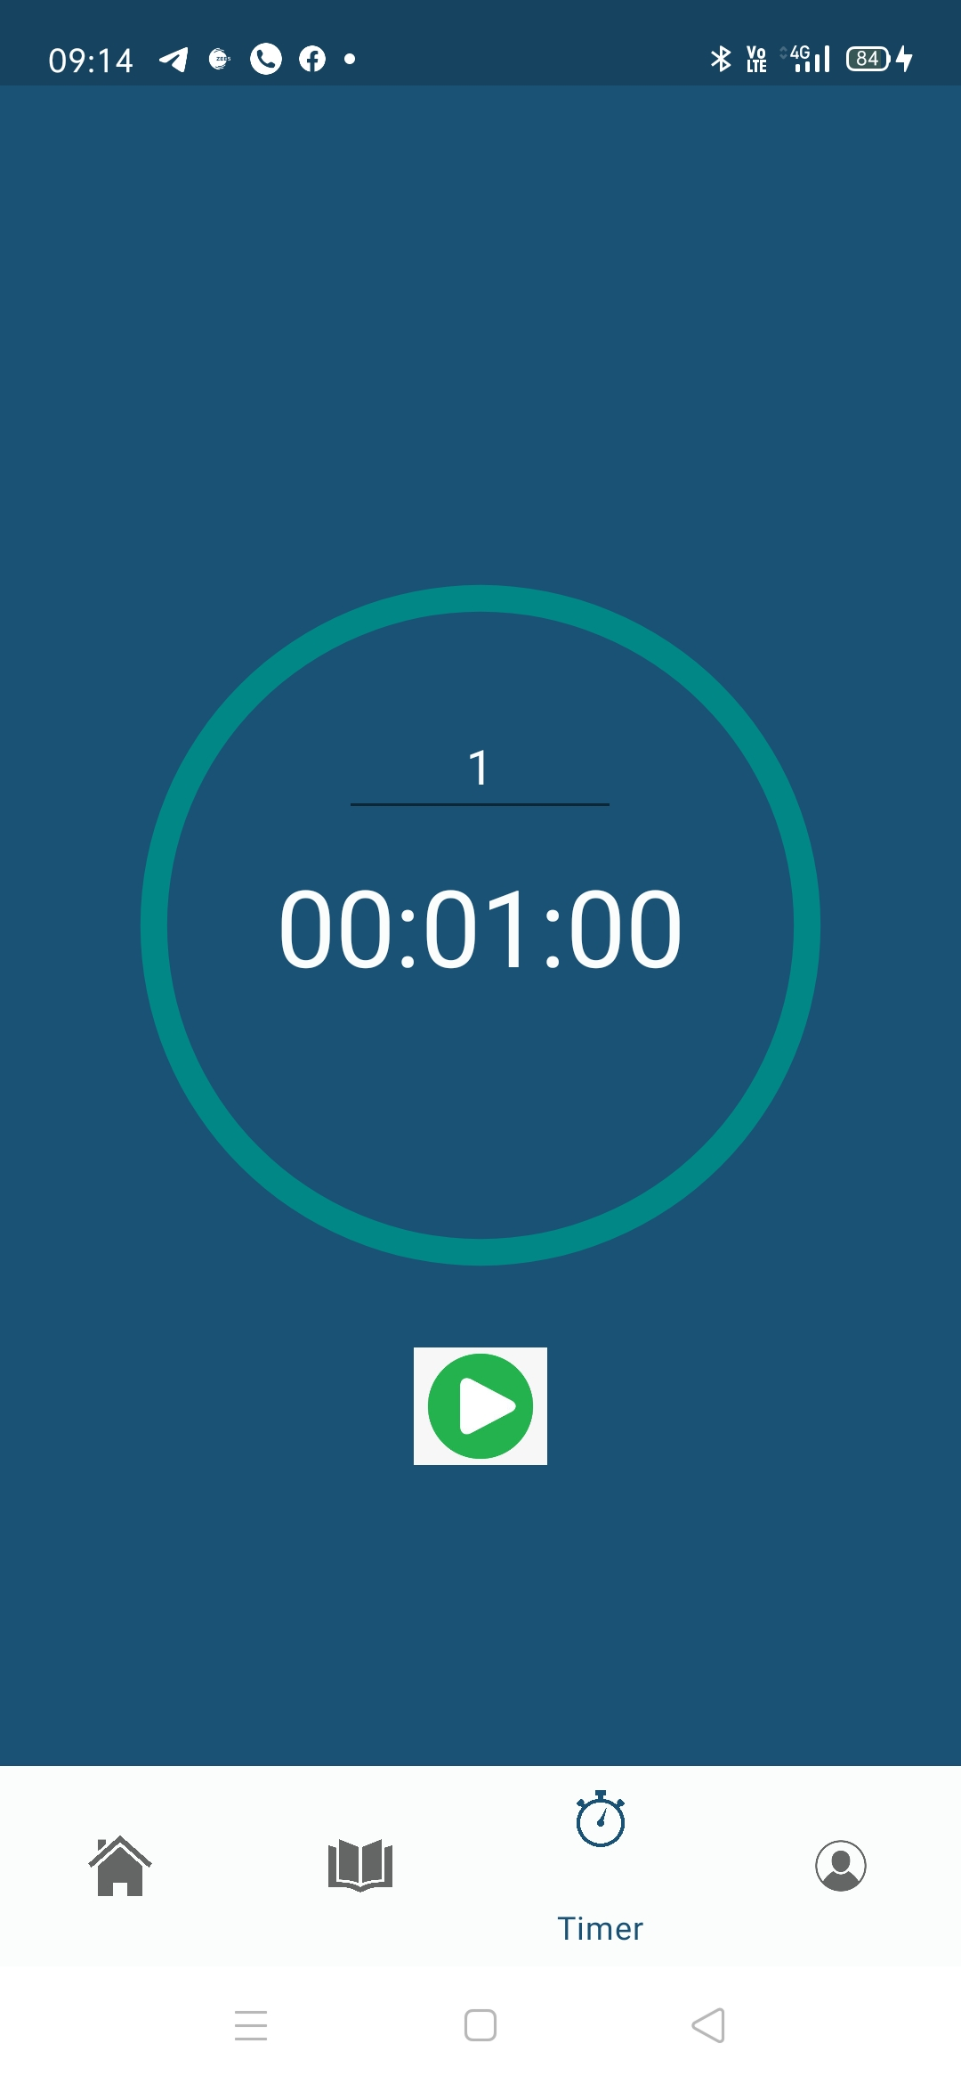
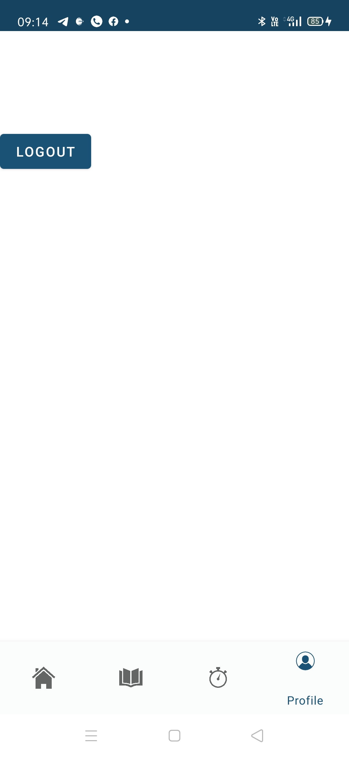
SCREENSHOTS

Slide 10
REFERENCES
KOTLIN
ANDROID STUDIOS
FIREBASE
FIREBASE AUTHENTICATION
UI

Slide 11
THANK YOU

